Slide 1
Deep Learning Project
Harold Gamarro
Joe Brian Malubay
Said Mejia
Juan Pablo Montoya

Slide 2
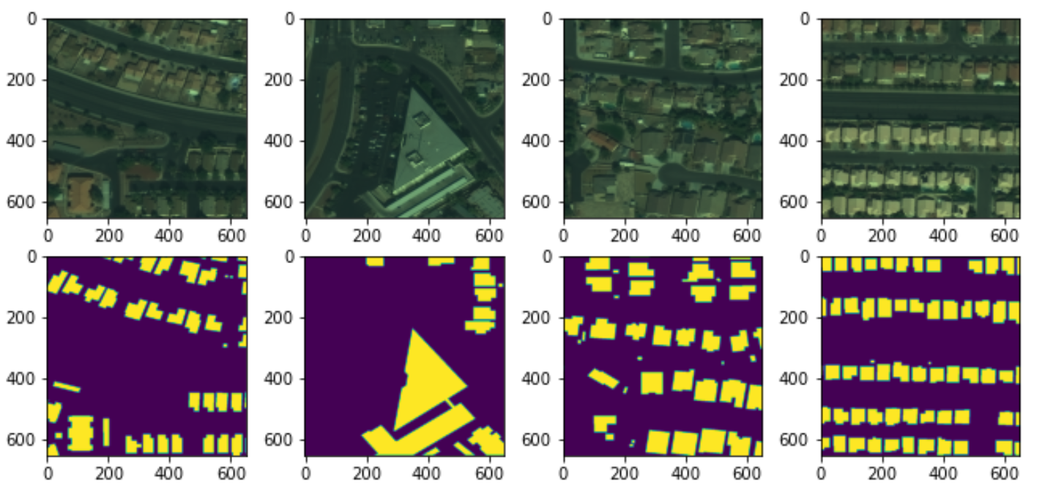
Spacenet Data processing for building detection
Input Image: 3 band geotiff
Input mask: Geojson
Created source code to convert images to jpegs for model input

Slide 3
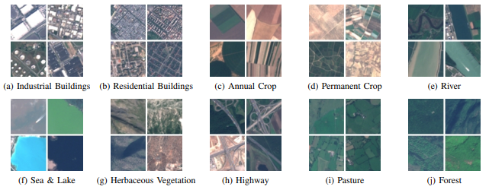
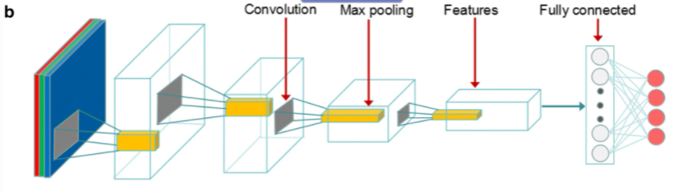
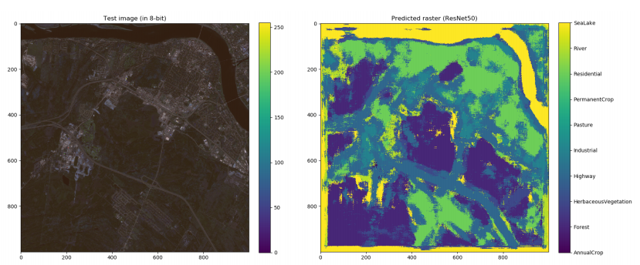
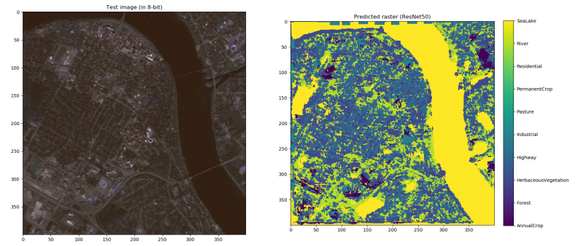
First Approach
It uses REsNet50 and they test it using an experimental image
REsNet50 architecture
Source: EuroSAT: A Novel Dataset and Deep Learning Benchmark for Land Use and Land Cover Classification
Source: LandUse / LandCover Classification using ResNet50

Slide 4
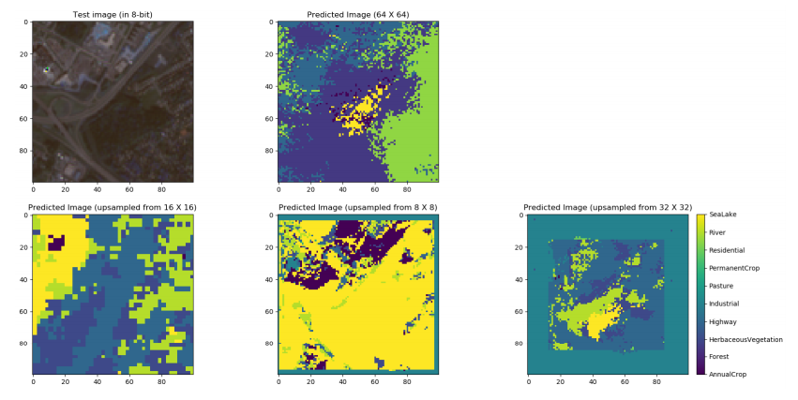
Problems

Slide 5
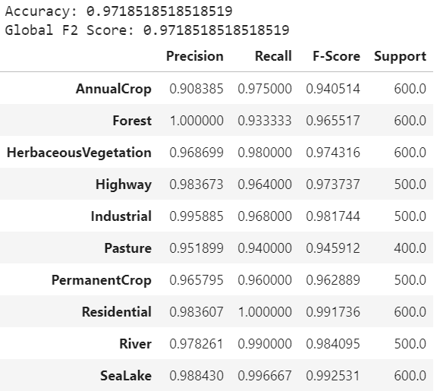
ResNet50 Results

Slide 6
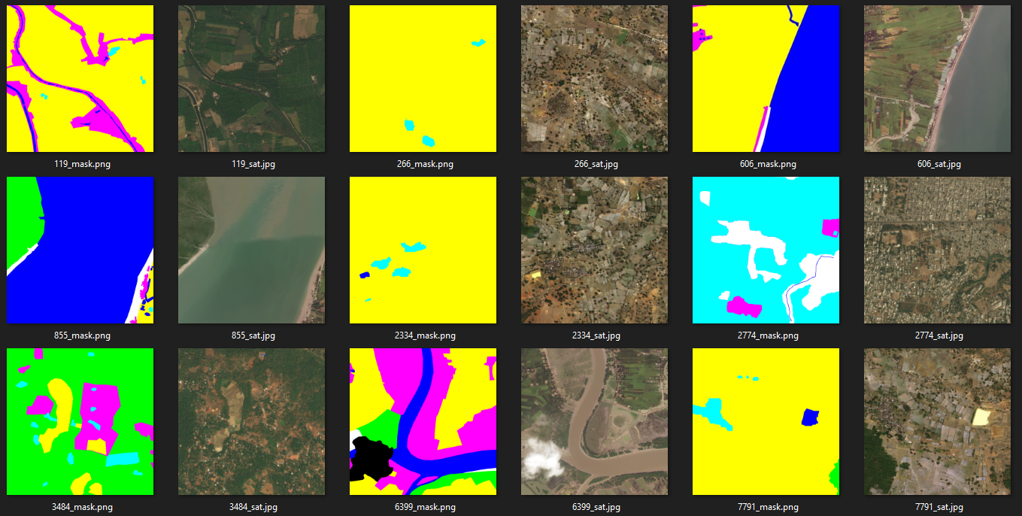
2nd Dataset

Slide 7
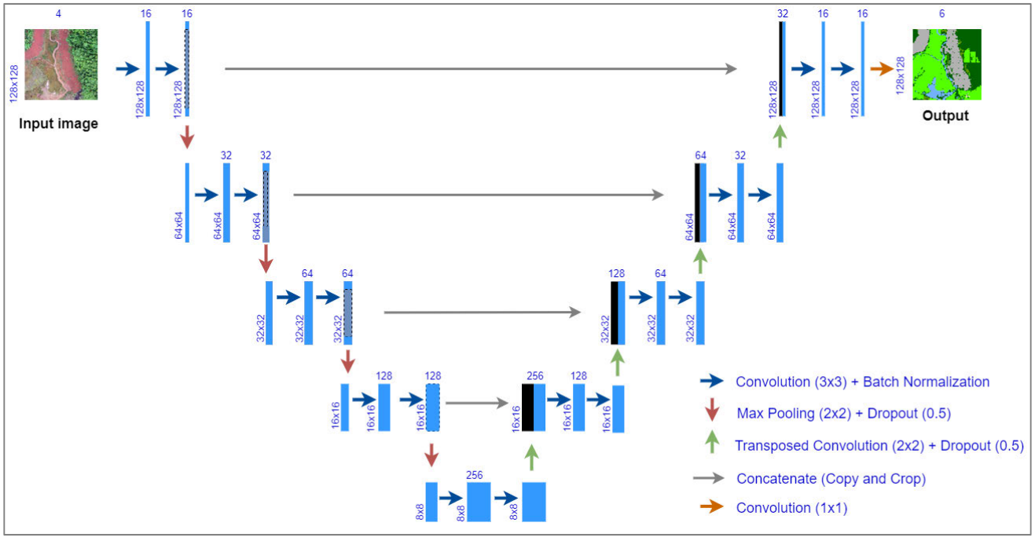
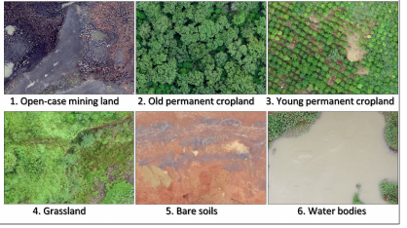
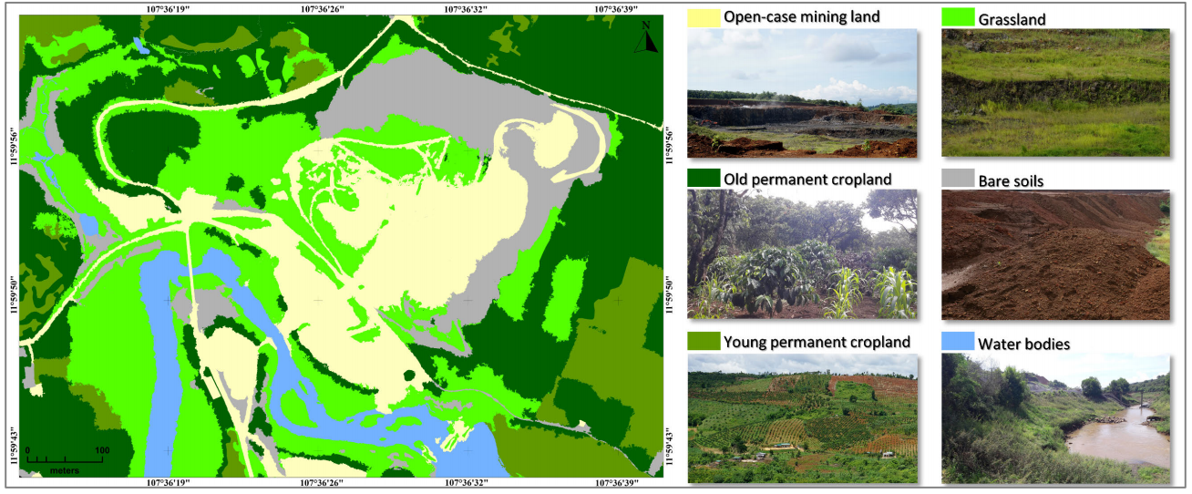
Second Approach U-Net
Image shape: 128x128x4
Source: U-Net Convolutional Networks for Mining Land Cover Classification Based on High-Resolution UAV Imagery

Slide 8
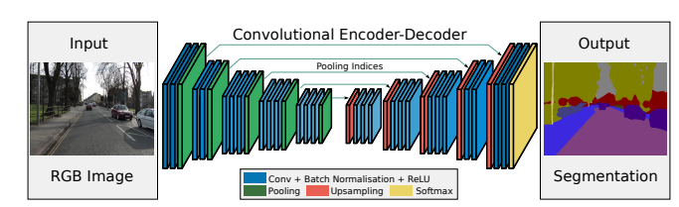
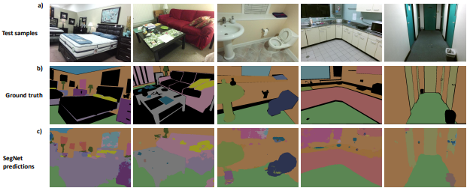
Third Approach SegNet
Source: SegNet: A Deep Convolutional Encoder-Decoder Architecture for Image Segmentation

Slide 9
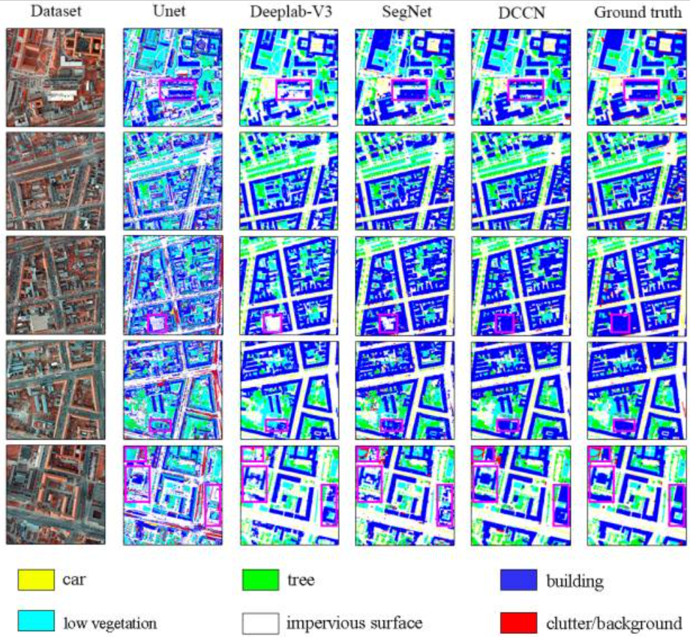
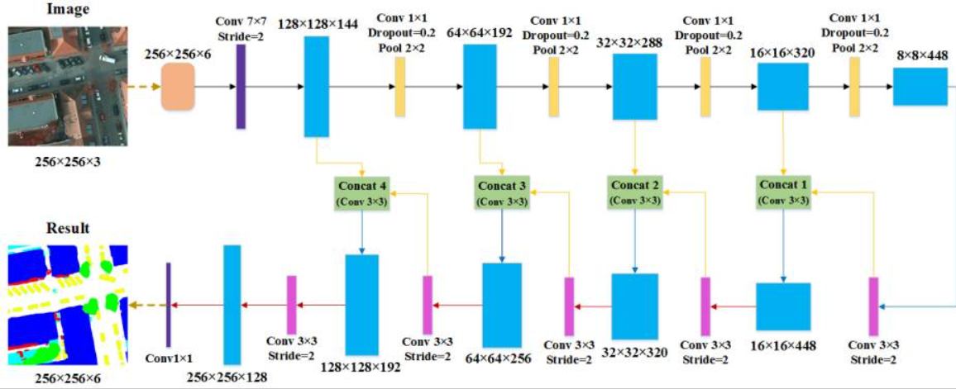
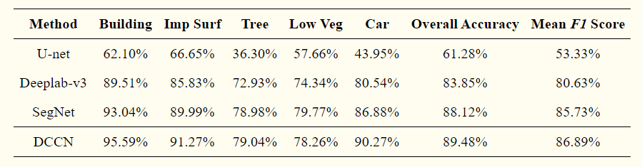
Source: https://www.ncbi.nlm.nih.gov/pmc/articles/PMC6631649/

Slide 10
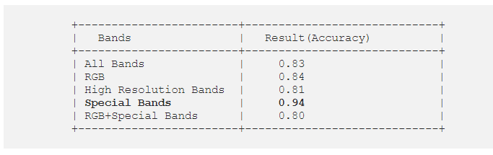
Comments
Develop the each of the 3 approaches
Use second approach using the first dataset from EuroSAT with 12 bands and make some modifications to the number of layers

Slide 11
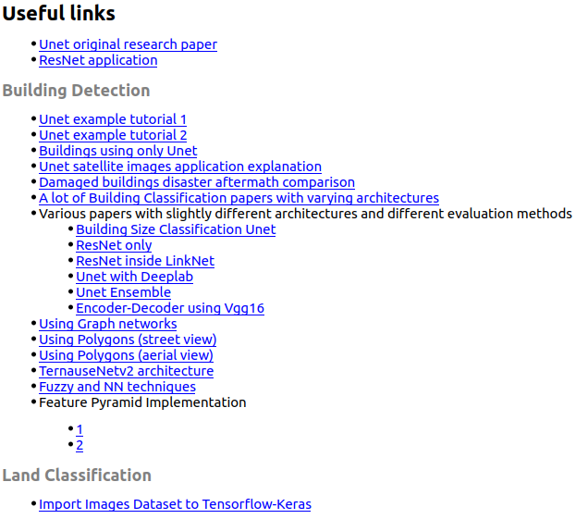
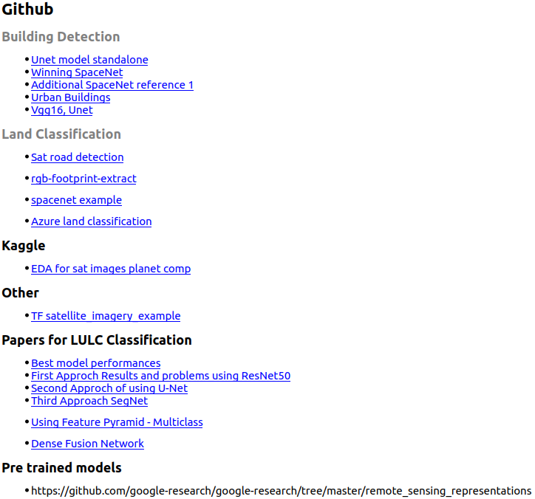

Slide 12
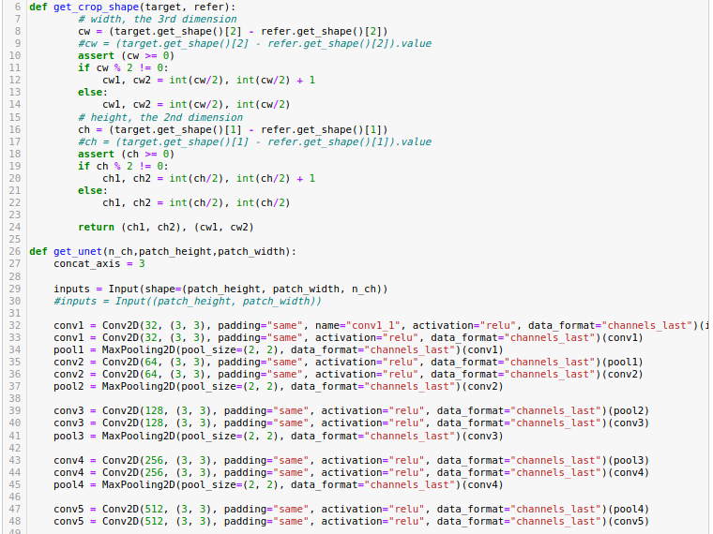
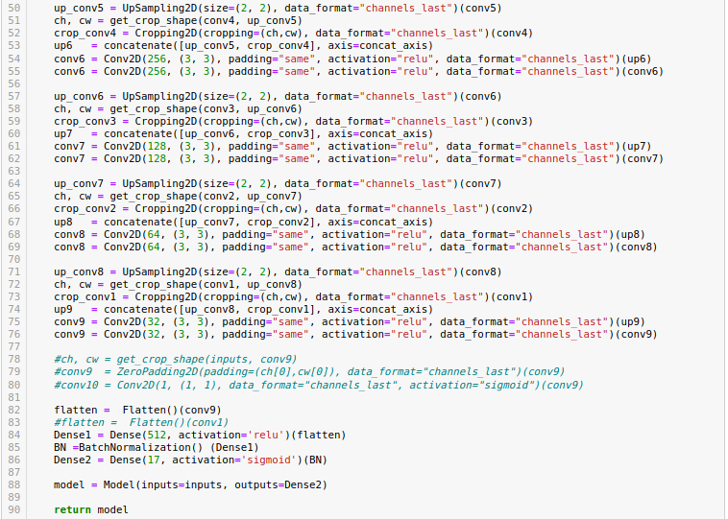

Slide 13
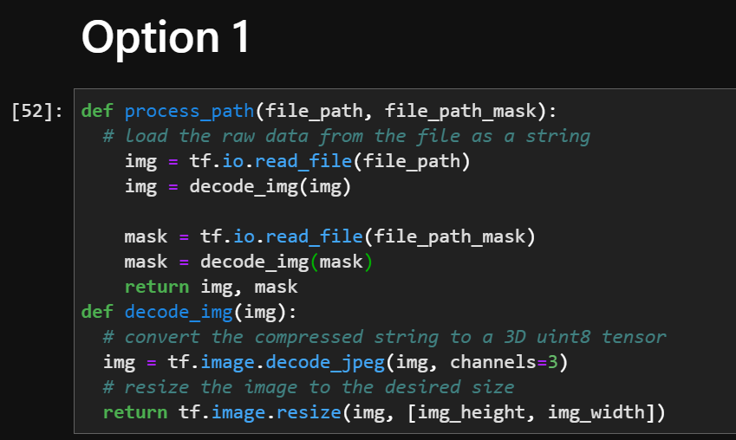
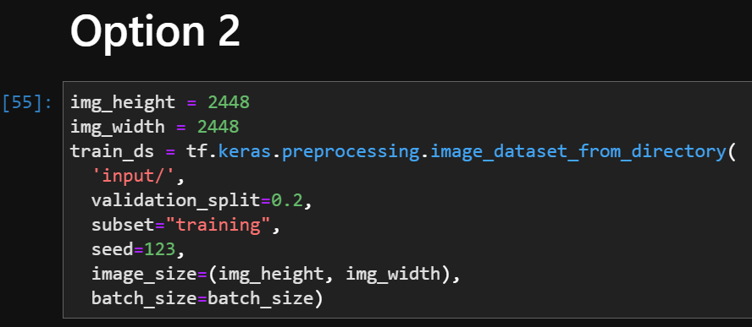
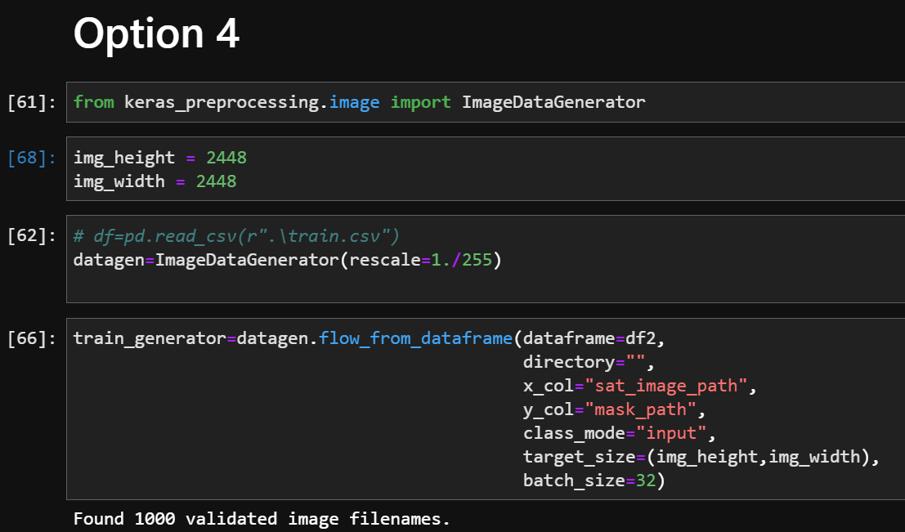
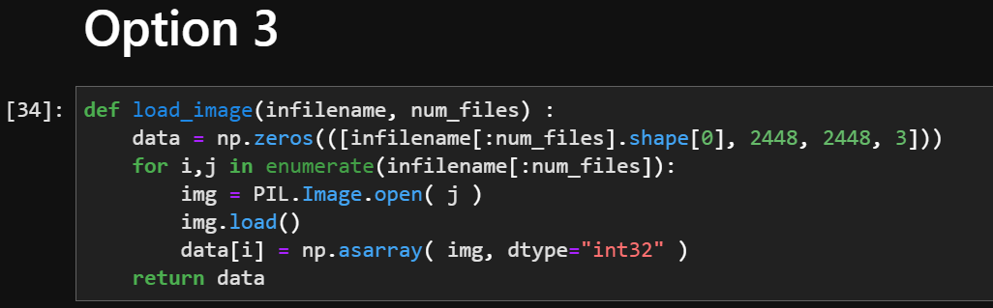
Import Image Segmentation Dataset

